Slide 1
S R M S student Result Management System
Atkotiya Bhavy (92300527183)

Slide 2
Synopsis :
The Result Management System (RMS) is a comprehensive platform designed to streamline the process of tracking, evaluating, and reporting performance outcomes across various sectors, including educational institutions, corporate environments, and governmental agencies. RMS facilitates the efficient management of results, providing a centralized system for input, analysis, and dissemination of performance data.

Slide 3
Introduction :
Welcome to the Result Management System (RMS), a robust platform designed to streamline the management and analysis of performance outcomes. This system simplifies processes for recording and evaluating results, generating reports, and overseeing performance metrics. With user-friendly interfaces and efficient functionalities, the RMS aims to enhance organizational efficiency and improve user experience. From tracking academic grades to evaluating project outcomes, this system provides essential tools to optimize result management. Whether handling performance evaluations or generating detailed reports, RMS is tailored to meet the needs of modern institutions effectively.

Slide 4
Features :
Features of the Result Management System:
Add Result: Administrators can easily input new performance results into the system, including details such as student or employee names, performance metrics, and evaluation dates.
Remove Result: This feature allows administrators to remove outdated or incorrect results from the database, ensuring data accuracy and relevance.
Update Result: Administrators can update existing performance records, including correcting errors, revising scores, or modifying evaluation criteria.
Manage Users: This feature enables administrators to manage user information, including registration details, performance history, and any related feedback or comments.
Manage Results: Administrators can efficiently manage results across various categories, including categorizing performance data, assigning evaluation criteria, and tracking overall performance status.
View Records: Administrators have access to comprehensive records of all performance data, including detailed information on results, metrics, and historical trends.
Issued Result Records: Administrators can view records of results issued to users, including details such as issue dates, evaluation status, and any associated feedback or remarks.
Search Functionality: Users can search for specific performance results using various criteria such as name, performance metrics, or evaluation dates, making it easy to find detailed information within the system.

Slide 5
Review Of Literature :
The literature on Result Management Systems (RMS) highlights the transformative role of technology in streamlining academic operations and enhancing the overall user experience for both administrators and students. As educational institutions increasingly adopt digital tools, several studies focus on the critical features and functionalities that an effective RMS should offer to meet the evolving needs of users.
Research by Patel et al. (2020) emphasizes the importance of user-friendly interfaces and robust functionalities in Result Management Systems. The study underlines essential features such as result entry, grading, and report generation, along with the ability to handle diverse grading systems. Additionally, they highlight the importance of student information management for easy tracking of academic progress across different semesters and courses.
Further, Singh and Gupta (2021) explore key components of RMS, including data security, user access control, and integration with other institutional systems like Student Information Systems (SIS). They stress that a secure, role-based access control (RBAC) mechanism ensures that sensitive data is only accessible to authorized personnel, while allowing for efficient data management across various stakeholders.

Slide 6
Technical Description :
The platform will be developed using a combination of the following technologies:
1. Language : Python
2. Search Functionality :
4.1 HARDWARE REQUIREMENTS :
RAM : Minimum 4 GB
PROCESSOR : 11th Gen Intel(R) Core(TM) i5-10300H CPU @ 2.50GHz 2.50 GHz
VERSION : Windows 8,10 & 11.
SYSTEM TYPE : 64 Bit operating system.
4.2 SOFTWARE REQUIREMENTS :
USED SOFTWARE : Python IDLE
USED DATA BASE : Sqlite3

Slide 7
Module Discription :
There Are 8 Modules In My Project.
1. Login
2. Dashboard
3. Add Courses
4. Add Examination
5. View Results
6. Results
7. Logout
8. Exit

Slide 8
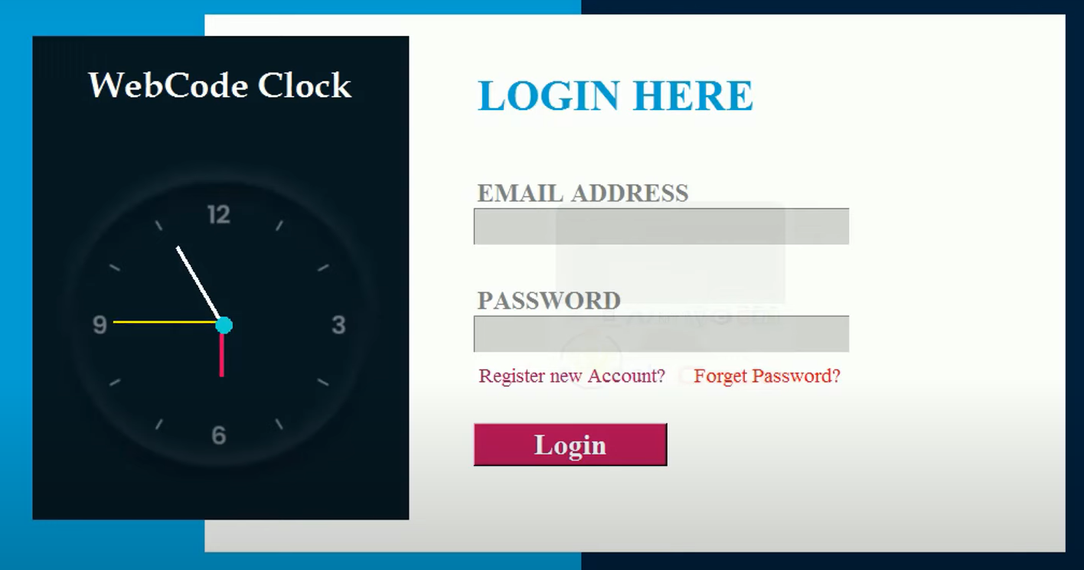
Screen Design :
Login Page :

Slide 9
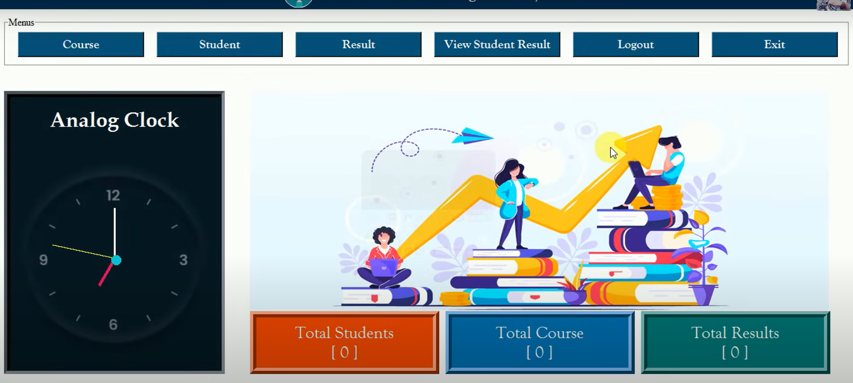
Screen Design :
2. Dashboard Page :

Slide 10
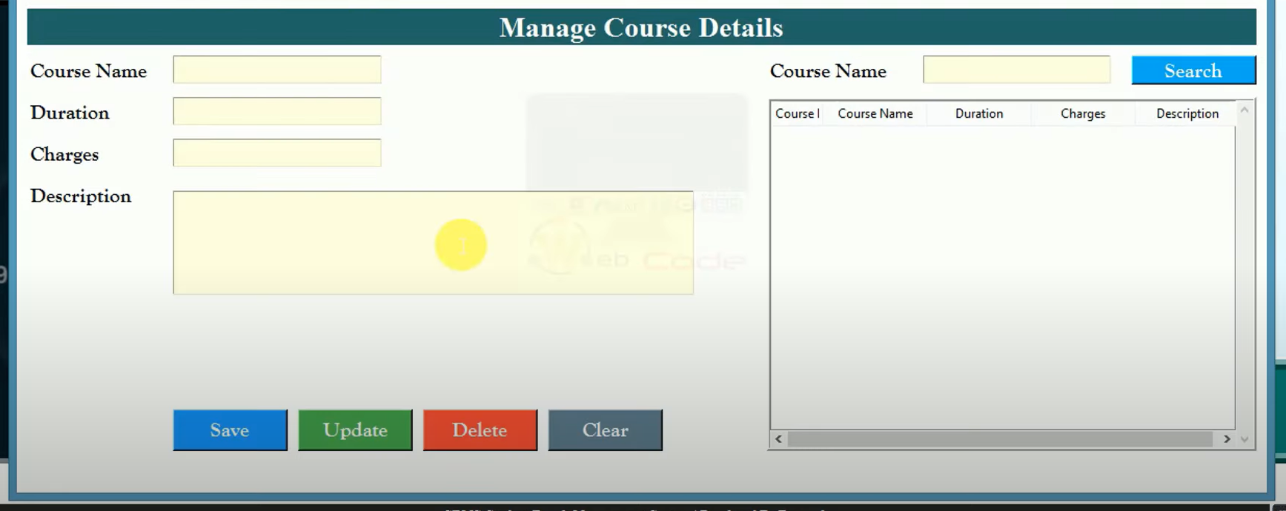
Screen Design :
3. Manage Course Page :

Slide 11
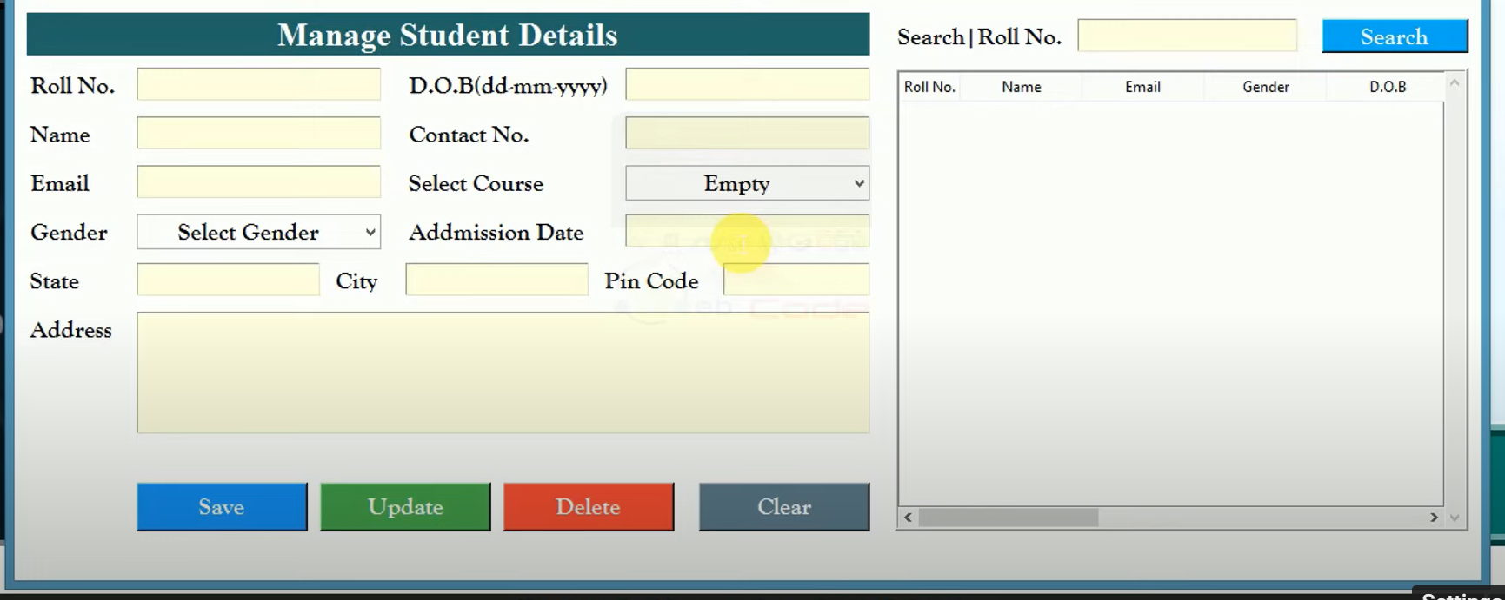
Screen Design :
4. Manage Student Page :

Slide 12
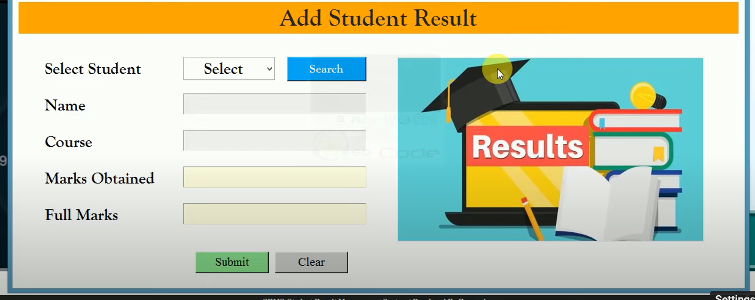
Screen Design :
5. Result Page :

Slide 13
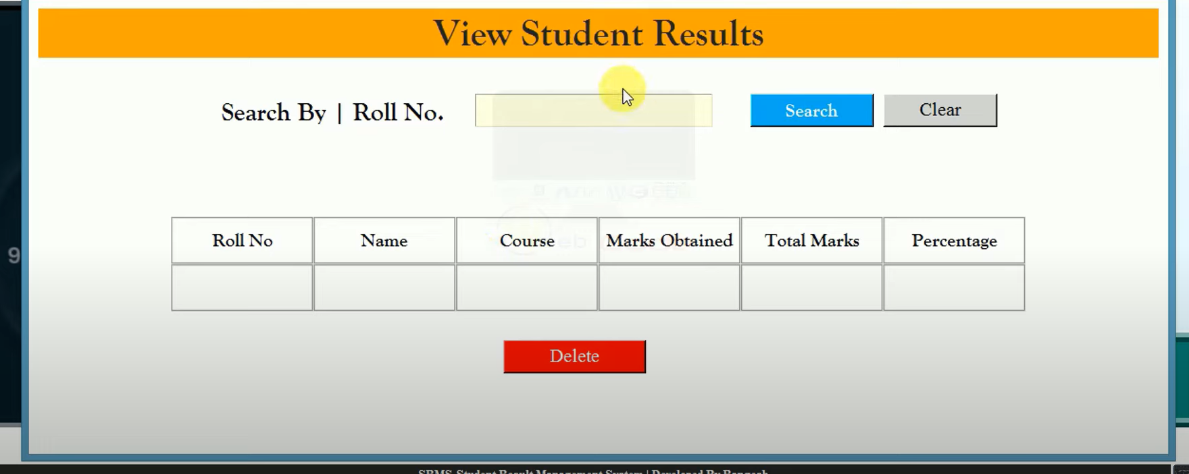
Screen Design :
6. View Result Page :

Slide 14
Algorithm :
Step 1: Create Data Structures
Create data structures to store information about students, courses, assessments, and results.
Add Student:
Step 2: Prompt the user (e.g., administrator) to enter details of the student (such as name, student ID, contact information, etc.).
Add the student to the system’s database.
Remove Student:
Step 3: Prompt the user to enter the student’s identifier (such as student ID).
Remove the student from the system’s database.
Add Course:
Step 4: Prompt the user to enter details of the course (such as course title, course code, instructor, etc.).
Add the course to the system’s database.
Remove Course:
Step 5: Prompt the user to enter the course identifier (such as course code).
Remove the course from the system’s database.
Enroll Student:
Step 6: Prompt the user to input the student’s ID and the course they wish to enroll in.
Enroll the student in the specified course and update records.
Assign Grade:
Step 7: Prompt the user to input the student’s ID, course code, and the grade to be assigned.
Record the grade in the system.
Search Student Results:
Step 8: Prompt the user to input search criteria (student ID, course code, etc.).
Display the results and grades for the student based on the search criteria.
Generate Reports:
Step 9: Generate reports on various aspects such as overall student performance, average grades per course, etc.
User Management:
Step 10: Add, remove, or modify user information (such as name, role, contact details, etc.).
Exit:
Step 11: End the program.

Slide 15
Flowcharts :
START
ADMIN
LOGIN
NO YES
REGISTER
Yes
SHOW
RMS DASHBOARD
MANAGE
COURSE & RESULTS
ENTER E-MAIL
PASS WORD
VIEW
RECORDS
PRESS LOGIN btn
STOP

Slide 16
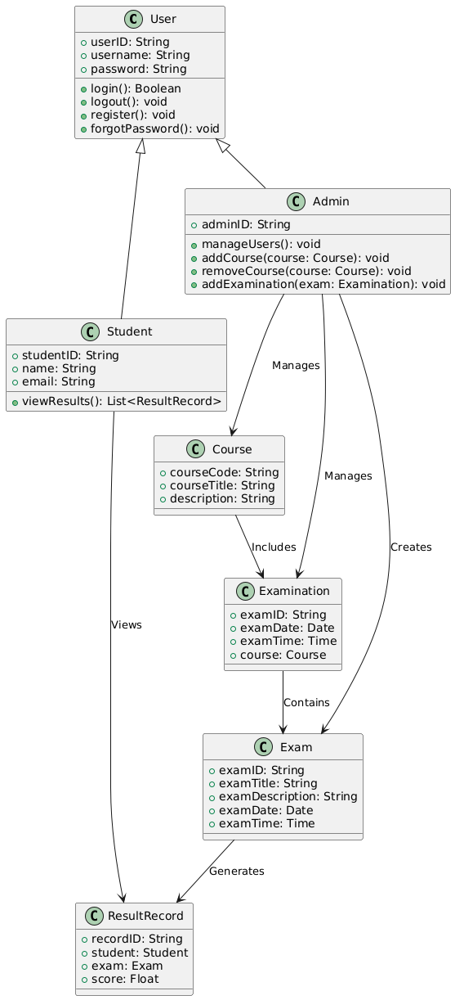
UML Diagrams:
Class diagram :

Slide 17
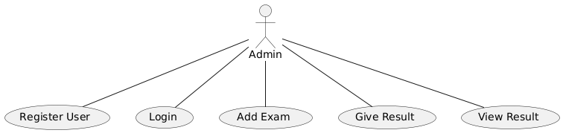
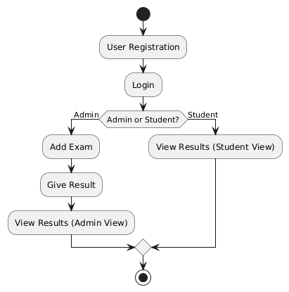
UML Diagrams:
Use Case Diagram :
Activity Diagram :

Slide 18
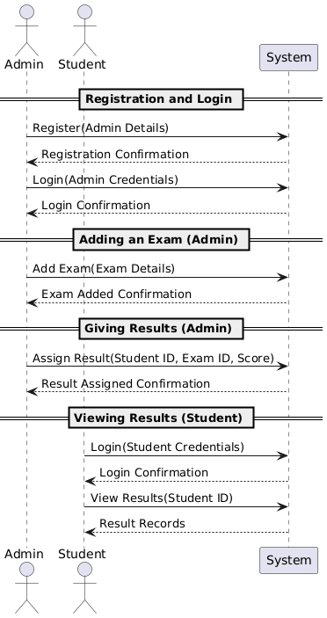
UML Diagrams:
Sequence Diagram :

Slide 19
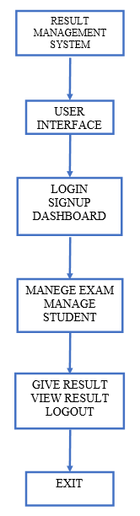
UML Diagrams:
Data Flow Diagram :

Slide 20
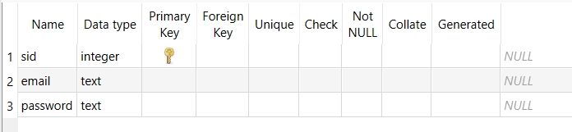
Database Design:
User Register Table :

Slide 21
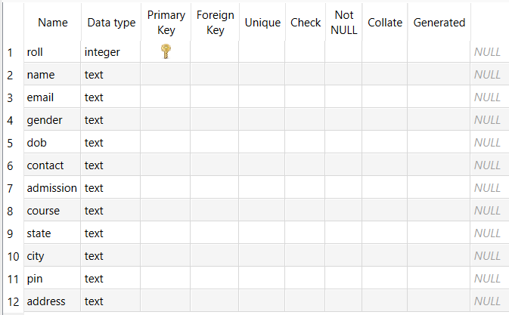
Database Design:
Student Details Table :

Slide 22
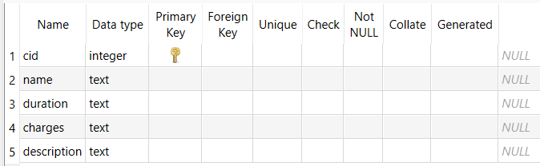
Database Design:
Course Details Table :

Slide 23
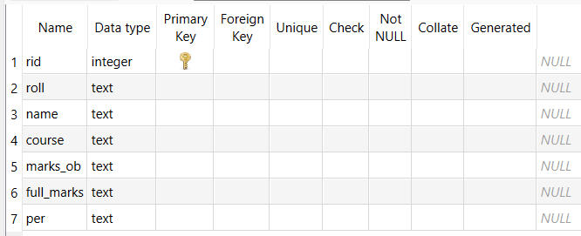
Database Design:
Result Details Table :

Slide 24
Conclusion:
We Have Successfully Implemented The Program . Working Experience With Our Project Guide Is One Of The Unique Experiences. Our Project Guide Prof. Jignesh Kariya Provided Full Support To Us he Always Helped Us Like Our Friend And Companion In Any Situation Or Error On Our Project In A Professional Guide They Provide The Information Required Us In Any Time.
Working Experience With Our Teammates Was Very Unique Together We Learn So Many Things.
Also, The Other Faculty Members Related FOCA Department Had Helped Us In Any Situation By Leap And Bounds.

Slide 25
Learning During Project Work :
When We Are Working On The Mini Project, We Learn Lots Of Things, And We Also Get Knowledge About Coding.
We Also Learned How To Use File Handling To Manage.

Slide 26
Bibliography :
TEXT BOOK :
1. Programing in Python, E. Balagurusamy, McGraw Hill, 7th Edition.
WEB REFERENCES :
https://www.w3schools.com/python/index.php
https://www.tutorialspoint.com/pythonprogramming/index.htm

